Slide 1
UNIVERSIDAD AUTÓNOMA DEL ESTADO DE HIDALGO ESCUELA SUPERIOR DE ZIMAPÁN
Licenciatura en Contaduría
Logros y experiencias. Lengua Extranjera.
L.E.L.I. Paulina Trujillo Castillo
Julio – Diciembre 2016

Slide 2
Resumen (Abstract)
La siguiente presentación muestra el grado de seguridad que expresamos al utilizar verbos modales (específicamente Will y May).
The following slides show degrees of certatinty we express when we use modal verbs (especifically Will and May).

Slide 3
Palabras clave (Keywords):
Will, may.

Slide 4
Objetivo general:
El alumno será capaz de proporcionar y solicitar información básica de manera escrita y oral acerca de acciones y actividades que indiquen posibles eventos en el futuro, intenciones, posibles planes y promesas.

Slide 5
Nombre de la unidad:
2. Planear proyectos futuros
Objetivo de la unidad:
Entender y realizar de manera oral y escrita planes de proyectos futuros así como compromisos, posibilidad, y gustos y preferencias con referencia al futuro.

Slide 6
Tema:
2. 1. 3. Expresar posibilidad con referencia al futuro.

Slide 7
Desarrollo del Tema:
Modal verbs express ability, possibility, need or any other condition. They are auxiliaries we mainly use to talk about the future or conditionals.
As in Spanish we do not have these kind of verbs, it is really important to understand the use of modal verbs.

Slide 8
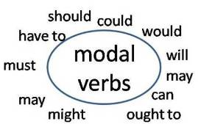
As complemetary verbs, modal verbs cannot be without other verbs. The “other verb” is always after the modal verb and goes in infinitive.

Slide 9
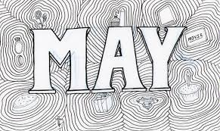
In this presentation we are not talk about all modal verbs, we are focus our attention in Will and May only.

Slide 10
We use may to indicate possibilities in the future. For example:

Slide 11
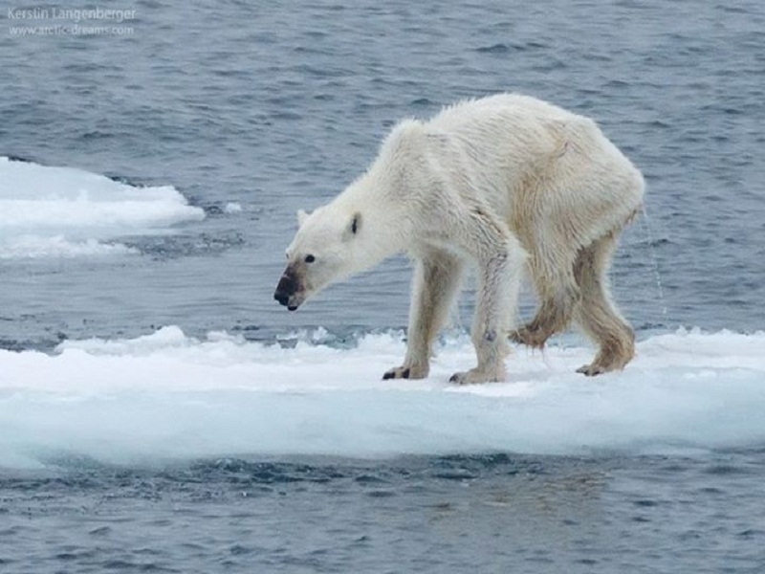
May can also express uncertain opinion, a guess based on very little information.
Polar bears may be starving.

Slide 12
The modal will expresses a person's attitude toward the factuality of a situation, the likelihood that a situation is true or false. The person infers this from known details. Will expresses that the speaker is certain. For example:

Slide 13
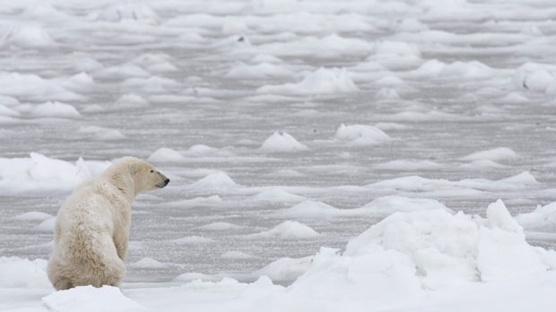
Polar bears will starve.

Slide 14
Note:
May and Will are modals verbs used in present or the future.

Slide 15
Referencias:
Paul Davies, M. G. (2014). Make it Real! Professional. Mexico: Universidad Autónoma del Estado Hidalgo.
Sevastopoulos, J. (18 de Julio de 2016). Grammar-Quizzes.com. Obtenido de http://www.grammar-quizzes.com/modal1.html

