Slide 1
UNIVERSIDAD AUTÓNOMA DEL ESTADO DE HIDALGO ESCUELA SUPERIOR DE ZIMAPÁN
Licenciatura en Contaduría
Decisiones personales. Lengua Extranjera.
L.E.L.I. Paulina Trujillo Castillo
Julio – Diciembre 2016

Slide 2
Resumen (Abstract)
En la siguiente serie de diapositivas, se muestran las diferentes expresiones de tiempo del Presente Perfecto.
In the following slides, different time expressions of the Present Perfect tense are shown.

Slide 3
Palabras clave (Keywords):
For, since, ever, never, just, already, yet.
Por, desde, alguna vez, nunca, acabar de, ya/ aún, todavía.

Slide 4
Objetivo general:
El alumno podrá describir experiencias y eventos sucedidos en un pasado indefinido acerca de temas comunes en contextos tales como el trabajo, la escuela, y de esparcimiento; estableciendo la duración de los mismos. El alumno podrá expresar la duración de eventos y su propósito.

Slide 5
Nombre de la unidad:
1. Descripción de experiencias.
Objetivo de la unidad:
Aprender frases y expresiones que se utilizan para comunicar de manera oral y/o escrita, eventos pasados así como de su repercusión en el presente.

Slide 6
Tema:
1. 1. 2. Indicar momentos específicos a lo largo de un periodo de tiempo.
1.1. 3. Hablar de logros.
1. 1. 4. Mencionar acciones que no han sido completadas.
1. 1. 5. Hablar de acciones que se han realizado en repetidas ocasiones.

Slide 7
Desarrollo del Tema:
Each tense in English has its own time expressions.
They are useful to identify tenses in an easier way. In the Present Perfect tense, we can find several time expressions to talk about different periods of time.

Slide 8
For and Since
For and Since are maybe the most common time expressions in the Present Perfect, but we use them differently.

Slide 9
We use for to talk about periods of time.
For two weeks
For one year
For ages
For sixt months
For a couple of weeks

Slide 10
We use since to establish a starting point.
Since my birthday
Since April
Since I was in High School
Since 2003

Slide 11
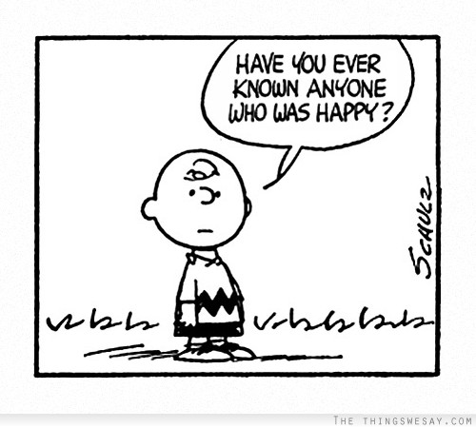
Ever
We use ever in questions and affirmative sentences.

Slide 12
Never
We use never in affirmative sentences; as this is a negative word, it is not posible to use it in negative ones.

Slide 13
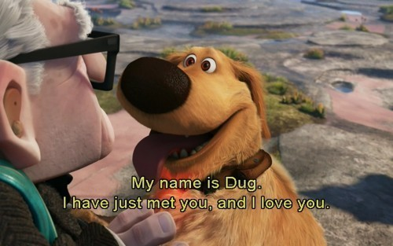
Just
We can use just to talk about an action which has finished a few minutes earlier.

Slide 14
Already
We use already in affirmative sentences and sometimes in questions, too.

Slide 15
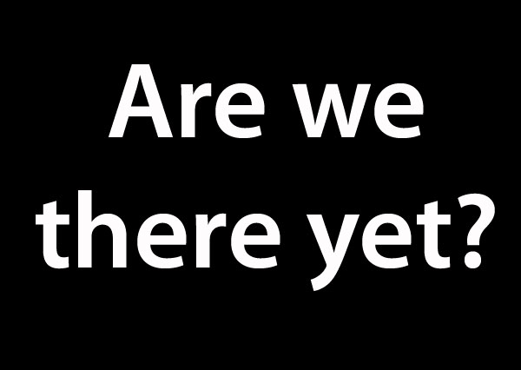
Yet
We use yet in both negative and interrogative sentences.

Slide 16
Conclusions
Time expressions are useful to identify the different tenses we are talking about.
There are time expressions for all tenses.
Remember that in the Present Perfect you cannot use time expressions such as:
two months ago
one year ago
last week
yesterday
when I was five years old

Slide 17
Referencias bibliográficas:
Paul Davies, M. G. (2014). Make it Real! Professional. Mexico: Universidad Autónoma del Estado Hidalgo.
Redston, C. Cunningham, G. (2005). Face2Face Pre – Intermediate Student’s Book. Cambridge, London. Cambridge University Press.

