Slide 1

  Área Académica: Física
  Tema: Magnetismo
  Profesor: Ing. María Guadalupe Vázquez Santos
  Periodo: Enero- Julio 2017

Slide 2

Tema: Magnetismo
Abstract:
In this presentation we will talk about Magnetism its characteristics, properties and classification, since most of the magnets that are currently used are artificial, this is because they can be manufactured with a greater magnetic intensity than the natural ones, besides being more solid And ease to be molded according to the form that is needed. Not all metals can be magnetized and others, although they can acquire this property, they are easily released, either by external effects or spontaneously. Many magnets are made with nickel and aluminum or iron with chromium, cobalt, tungsten or molybdenum.
Keywords: Magnetism, magnetite, field, artificial, temporal, permeability, vacuum, rock, iron and density.

Slide 3
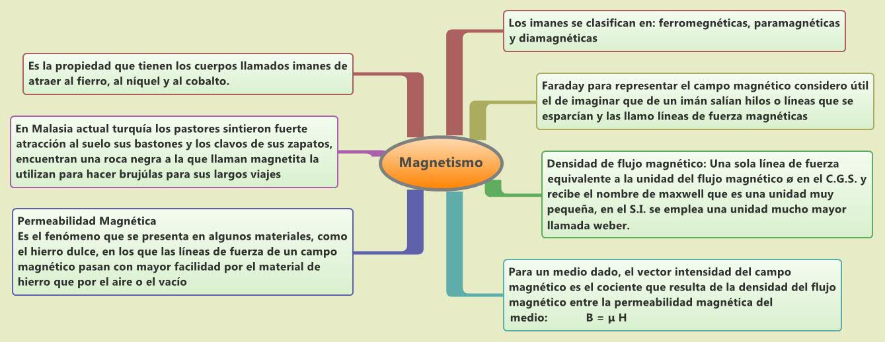

Slide 4
Referencias bibliográficas:
1.- FÍSICA CONCEPTUAL. PAUL. G. HEWITT.- Addison Wesley. Tercera ed. 1999.
2.- FÍSICA CONCEPTOS Y APLICACIONES. TIPPENS ed. Mc Graw- Hill
3.- FÍSICA. WILSON BUFFA. Pearson Prentice hall. Quinta ed. 2003
4.- FÍSICA GENERAL. HÉCTOR PÉREZ MONTIEL. Publicaciones Cultural. Segunda ed. 2000

